Slide 1
SMART MEDICAL APPOINTMENT SCHEDULING: OPTIMIZATION, MACHINE LEARNING, AND OVERBOOKING TO ENHANCE RESOURCE UTILIZATION
GUIDED BY :
Deepa K Daniel
Assistant Professor
Submission date:07-10-24
SUBMITTED BY : Nandana Nair M
PRN21CS071

Slide 2
ABSTRACT
The existing medical appointment system cannot address the inefficiency of medical appointment scheduling systems, which result in underutilized resources, long patient wait times, and idle clinician time.
This challenge is prevalent in healthcare and requires solutions that optimize both resource use and patient satisfaction.
The proposed idea integrates machine learning to predict patient no-shows and cancellations using historical data (demographic, social, and behavioral factors
Applies strategic overbooking to improve resource utilization
Includes dynamic scheduling to adapt to real-time patient flows and resource availability, ensuring an efficient and flexible scheduling system.
Simulations and real-world data demonstrate that the proposed system significantly improves appointment adherence, resource utilization, and patient throughput. The approach enhances efficiency without compromising patient care, making it a viable solution for optimizing healthcare appointment scheduling systems.

Slide 3
CONTENT
INTRODUCTION
LITERATURE SURVEY
PROPOSED METHODOLOGY
FINDINGS
RESULT
CONCLUSION
FUTURE ENHANCEMENT
REFERENCES

Slide 4
INTRODUCTION
Importance of Scheduling: Medical appointment scheduling is crucial for managing patient visits and healthcare resources like doctors, nurses, and equipment.
Patient Satisfaction: Patient waiting time is a key factor in determining satisfaction, with longer waits often leading to dissatisfaction.
Problem of Patient No-Shows: Medical centers face inefficiency due to patients missing appointments, wasting doctors' time and increasing wait times for others
Limitations of Current Solutions: Reminders and penalties have been used to reduce no-shows, but their success has been limited
New Approach: The study proposes a model combining machine learning and overbooking to predict no-shows and fill empty slots. Tested with real data, this approach significantly improves scheduling efficiency and patient satisfaction.

Slide 5
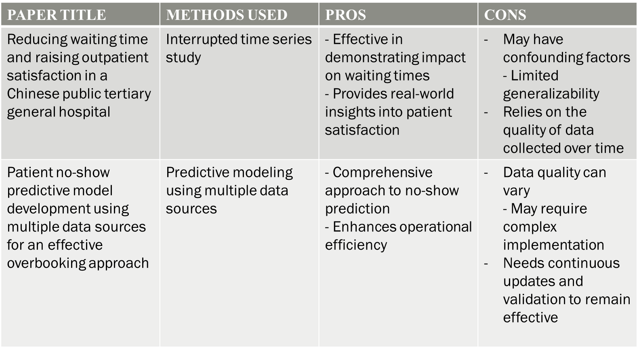
LITERATURE SURVEY

Slide 6
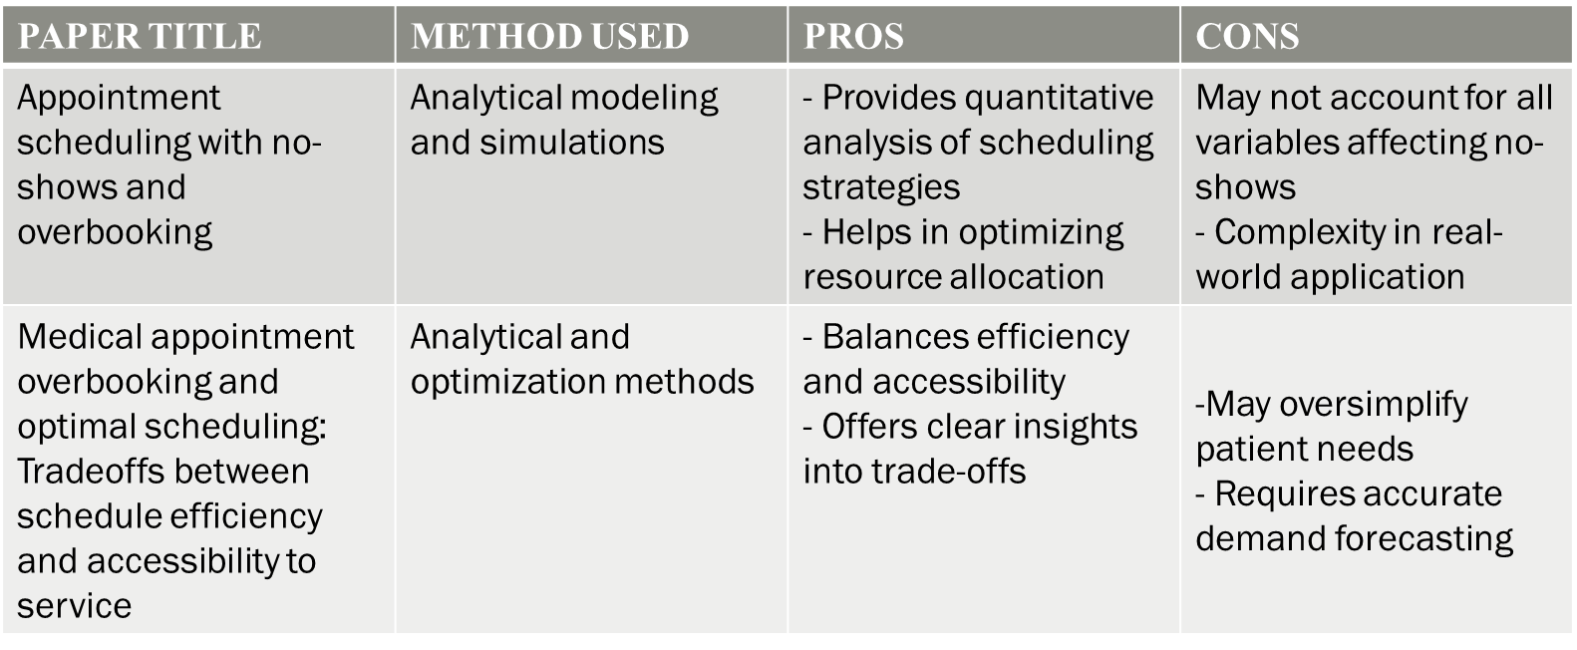
CONTD..

Slide 7
PROPOSED METHODOLOGY
DATA COLLECTION
FEATURE SELECTION
MACHINE LEARNING MODEL DEVELOPMENT
NO-SHOW PREDICTION
OVERBOOKING STRATEGY
IMPLEMENTATION AND TESTING
EVALUATION OF RESULTS

Slide 8
CONTD..
1. Data Collection
Gathering real-world data from medical appointments across various specialties.
The data set includes patient demographics, appointment types, historical attendance records, and other relevant attributes.
2. Feature Selection
Relevant features are identified that may influence a patient's likelihood of attending their appointment.
Features can include age, gender, previous no-show history, type of care needed, and time between appointment booking and the actual date.

Slide 9
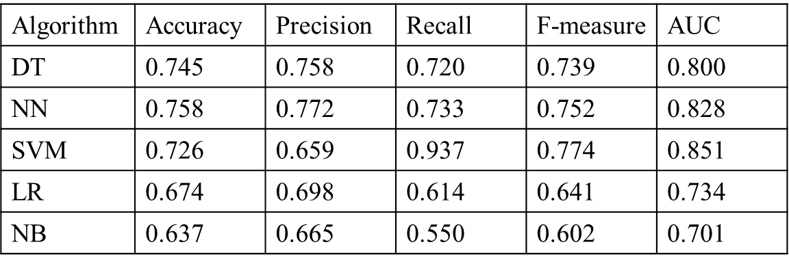
3. Machine Learning Model Development
Several algorithms, such as Decision Trees, Neural Networks, and Support Vector Machines, are tested. The best-performing model is selected based on metrics like accuracy and area under the curve (AUC).
4. No-Show Prediction
Once the model is trained, it is used to predict the probability of no-shows for upcoming appointments.
This predictive capability allows healthcare providers to understand which patients are more likely to miss their appointments, enabling better scheduling decisions.

Slide 10

5. Overbooking Strategy
Scheduling more patients than available slots, based on the predicted likelihood of no-shows.
calculates how many additional patients can be scheduled in a controlled manner to optimize resource utilization without overwhelming the system.
6. Implementation and Testing
The scheduling system, informed by the machine learning predictions and overbooking strategy, is put to the test to evaluate its effectiveness in improving appointment occupancy rates and reducing idle time.
7. Evaluation of Results
The model is compared to existing scheduling practices.
Metrics such as appointment occupancy rates, patient satisfaction, and waiting times are analyzed to determine the effectiveness of the proposed methodology.

Slide 11
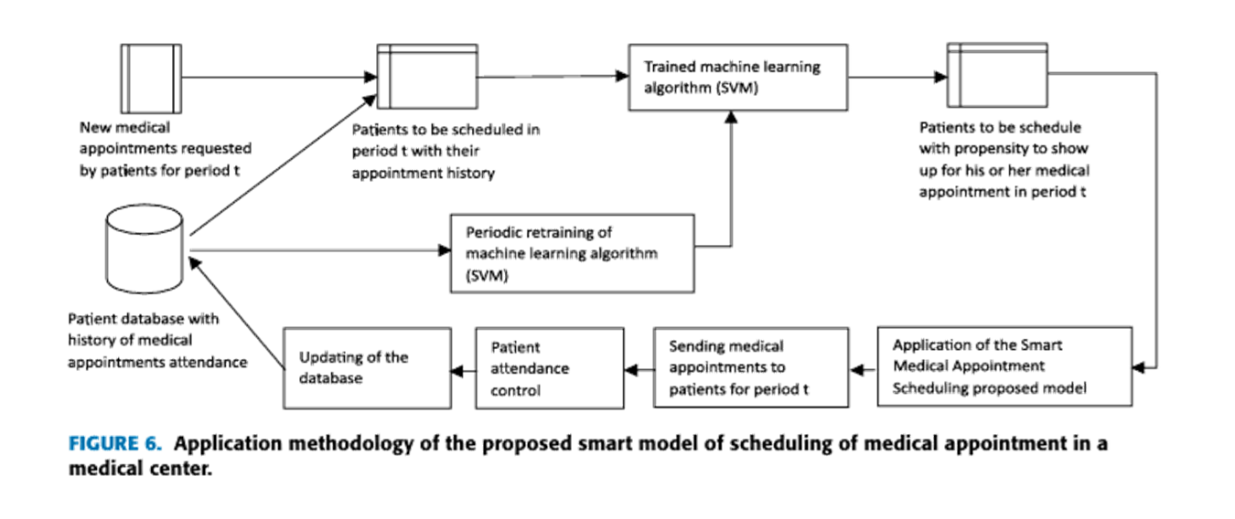
PROPOSED SMART MODEL:

Slide 12
CONTD..
Identify cohort of patients requesting appointments for period t.
Access patient attendance history from the database.
Extract key features for the Support Vector Machine (SVM) model.
Estimate each patient's propensity to attend using the trained model.
Implement smart scheduling model to allocate slots based on propensity.
Communicate appointment details to patients via designated channels.
Monitor attendance and update the patient database.
Periodically retrain the machine learning model (1-2 times/year) to adapt to changes in behavior.

Slide 13
FINDINGS
Increased Appointment Occupancy: The proposed model achieved an average occupancy rate of 56%, significantly higher than the 52% rate from traditional scheduling methods.
Enhanced Resource Utilization: By accurately predicting patient attendance, the model reduced idle time for doctors and improved the use of medical resources, leading to more efficient operations.
Shorter Waiting Times: The new scheduling approach minimized patient waiting times by effectively filling appointments based on predicted attendance, enhancing the patient experience.
Higher Patient Satisfaction: Improved scheduling efficiency resulted in greater patient satisfaction, as patients received more timely medical care and experienced shorter wait times.
Scalability: The model demonstrated the potential for scalability, allowing it to be applied across different departments and contexts within healthcare systems.

Slide 14
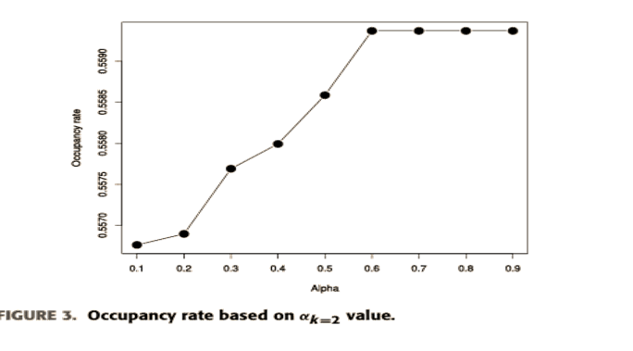
RESULTS
Occupancy Rate Improvement: The model improved the appointment occupancy rate to an average of 56%, compared to 52% with traditional scheduling methods.
Decreased Waiting Times: Patients experienced shorter waiting times due to better scheduling practices, leading to a more streamlined patient flow in the medical center.

Slide 15
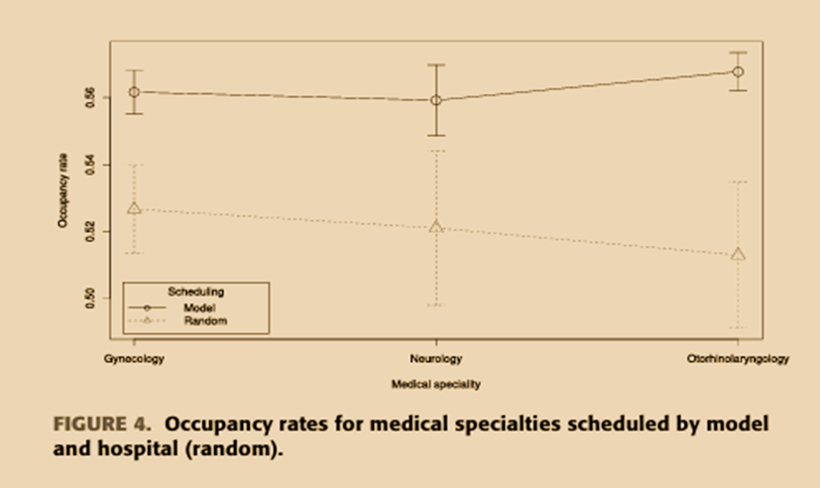
Efficiency in Scheduling: The use of machine learning predictions allowed for more effective scheduling of appointments, resulting in better allocation of medical resources and reduced idle time for doctors.
Increased Patient Attendance: The model facilitated a significant increase in patient attendance, as it allowed for strategic overbooking based on the likelihood of no-shows.
Statistical Validation: The findings were validated through statistical analysis, demonstrating a significant difference in efficiency and patient satisfaction when compared to the hospital's previous random scheduling practices

Slide 16
FUTURE ENHANCEMENT
Real-Time Data Integration: Incorporating real-time patient data can improve the accuracy of attendance predictions, allowing the model to adapt to changing behaviors.
Expanded Feature Set: Adding variables like transportation issues and patient feedback could enhance predictive capabilities and identify patterns in attendance.
Personalized Scheduling: Implementing tailored appointment reminders based on individual patient preferences may further reduce no-show rates and boost engagement.
Broader Application: Adapting the model for other contexts, such as surgical scheduling or emergency departments, could improve efficiency across various healthcare services.
Routine Model Retraining: Regularly retraining the machine learning model will help maintain its accuracy and ensure it reflects current patient behaviors.
These enhancements aim to optimize scheduling, improve patient care, and increase efficiency in healthcare systems.

Slide 17
CONCLUSION
The model integrates SVM-based patient attendance predictions with an overbooking strategy, significantly improving resource utilization and appointment efficiency.
Higher occupancy rates were achieved compared to traditional scheduling methods, enhancing patient access to care and service quality.

Slide 18
REFERENCES
[1] J. Sun, Q. Lin, P. Zhao, Q. Zhang, K. Xu, H. Chen, C. J. Hu, M. Stuntz,H. Li, and Y. Liu, ‘‘Reducing waiting time and raising outpatient satisfaction in a Chinese public tertiary general hospital—An interrupted time series study,’’ BMC Public Health, vol. 17, no. 1, pp. 1–11, Dec. 2017.
[2] D A. Hanauer and Y. Huang, ‘‘Patient no-show predictive model development using multiple data sources for an effective overbooking approach,’’ Appl. Clin. Informat., vol. 5, no. 3, pp. 836–860, 2014.
[3] Y.-H.Kuo, H.Balasubramanian, andY.Chen,‘‘Medical appointment over booking and optimal scheduling: Tradeoffs between schedule efficiency and accessibility to service,’’ Flexible Services Manuf. J., vol. 32, no. 1, pp. 72–101, Mar. 2020.
[4] C. Zacharias and M. Pinedo, ‘‘Appointment scheduling with no-shows and overbooking,’’ Prod. Oper. Manage., vol. 23, no. 5, pp. 788–801, May 2014

Slide 19
THANK YOU

